Slide 1
Computational
Geometry
Robotics
DDP

Slide 2
Path Planning
Approach / Tools
Inputs
Environment
Cluttered Environment
Convex Hull / Voronoi Diagrams
Pre-built Maps
All three blocks are possible together
Map Building
Dissembling Routines
Navigation Planning in cave like environment
Only one branch can be used at once
Model Based
On-the-go scanning
Applications
Obstacle geometry of the order of robotic agent.
Local Path Planning
Dynamic Environment

Slide 3
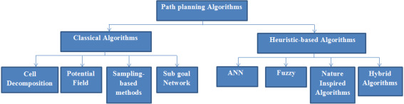
Path Planning Algorithms
Artificial Potential Fields
Geometric Algorithms
Grid based Search
Interval Based Search
Sampling based Algorithms
Visibility Farthest Ray Tracing
Notes:
A*
D*
Dijkstra’s
Genetic
Firefly
Ant colony
RRT
Fuzzy

Slide 4
Initial Research
Is there any standard environment to build and simulate path planning algorithms?
-- No, For every application, custom environment is being used.
Predefined file formats/standards ?
-- Nothing. Everything is custom
Predefined file formats/standards ?
-- Nothing. Everything is custom

Slide 5
Project Plan Proposal
To keep initial Project topic as “Path Planning algorithms in cluttered environment using computational geometry approaches”
And build:
Build Implementation and visualization Environment in C++ (OpenGL)
Test and compare all the existing 2D-Path Planning algorithms in this environment
Extend algorithm to 3D environment and repeat
This will take about 10 days
Based on results and experience; redefine project statement around identified “stress points”

Slide 6
Benefits
I’m lacking in experience on which algorithm is better under what conditions – addresses this issue
What are the shortcomings in these algorithms, which we can address in our algorithm
Build Implementation and visualization Environment in C++ (OpenGL)
Test and compare all the existing 2D-Path Planning algorithms in this environment
Extend algorithm to 3D environment and repeat
A more clear idea towards file formats and representations to be used.
Reuse this same code throughout the project progress

Slide 7
Existing research works and some papers as proof
Idea:
* Dynamically representing an object through a varying number of ellipses
* More finer the obstacle details required; represent it with 100s ellipse.
* More coarser the obstacle details required; represent it with 1 ellipsoid or combine several obstacles in 1 ellipsoid.
Cgal
Characteristics of a good algorithm;
* Lesser complexity
* Least caliberation time/ time in planning step. Rest of the computations can be done while moving. And it should be faster than “robot movement speed” :P

Slide 8
Model based vs sampling based
Model based – configuration space, workspace being represented as equations
Holonomic/non-holonomic ?
https://www.researchgate.net/profile/Bhanu-Chander-V
https://link.springer.com/chapter/10.1007/978-981-10-8597-0_2

Slide 9
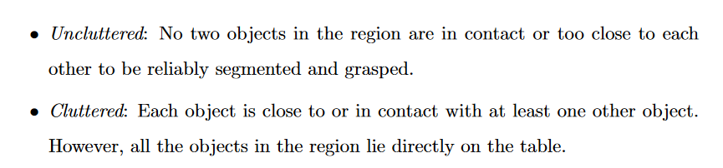
To Explore
Octree – OctoMap?
http://ompl.kavrakilab.org/blog.html ?
The Open Motion Planning Library – GitHub

Slide 10
Applications of cluttered, unstructured and 3D enviroment
navigating busy streets, articulated robots tirelessly sorting packages in warehouses, feeding people in care homes and mobile robots assisting in rescue operations

Slide 11
Research Papers
Mobile Robot Navigation in Cluttered Environment using Reactive Elliptic Trajectories
https://reader.elsevier.com/reader/sd/pii/S1474667016458428?token=36FD302EE82606FED8598F1AAD9694B16216D3BACCE25F72FDBABDAC42E1264D3BACF0870EAC4BBB77D31485C6DFB56C&originRegion=eu-west-1&originCreation=20220829173859
Navigation in Three-Dimensional Cluttered Environments for Mobile Manipulation
https://www.cs.cmu.edu/~maxim/files/planfor3Dnav_icra12.pdf
Efficient Motion Planning in Cluttered Environment Aditya Vamsikrishna Mandalika

Slide 12
A Refined Direction and plan of action
To compute ellipses (maybe by PCA) from given grid points
To find voronoi diagrams of ellipses
- sampling based
- on the lines of existing research work on circles in the lab
Path Planning based on generated voronoi diagrams
- voronoi edges so formed will not be straight lines → asks for sophisticated controls
- so look for near straight line paths or closed form equations of the paths

Slide 13
Plan to meet current plan
Implement atleast RRT and some graph and sampling based path planning problems
- A*, D*, Dijkstra’s
- Moving on from Grid – Based Algorithms to data based algo → what we can see using sensors
- Interface load paint bitmap images in opengl → No need → Just read bitmap instead and render it as grid ; according to need
- Correct code structure this way
- Run → Genetic Algo, Firefly, Ant colony, RRT ,Fuzzy on these images/canvases based data
- Do this : https://www.researchgate.net/publication/324962143_Comparison_of_optimal_path_planning_algorithms
Heading on to 2D voronoi diagram based path planning methods
Setting up C-GAL library in the environment
Taking it to the next level --- ie. Voronoi paths and path planning in 3D space
Wooossshhhhhhhh!
https://link.springer.com/article/10.1007/s10878-022-00846-1

Slide 14
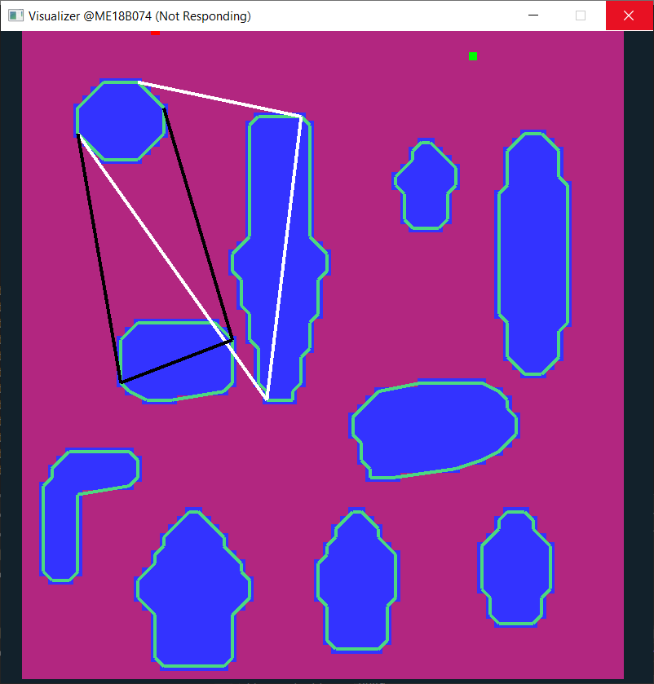
Voronoi Diagram Algo

Slide 15
Voronoi Diagram Algo

Slide 16
Voronoi Diagram Algo

Slide 17
Voronoi Diagram Algo

Slide 18
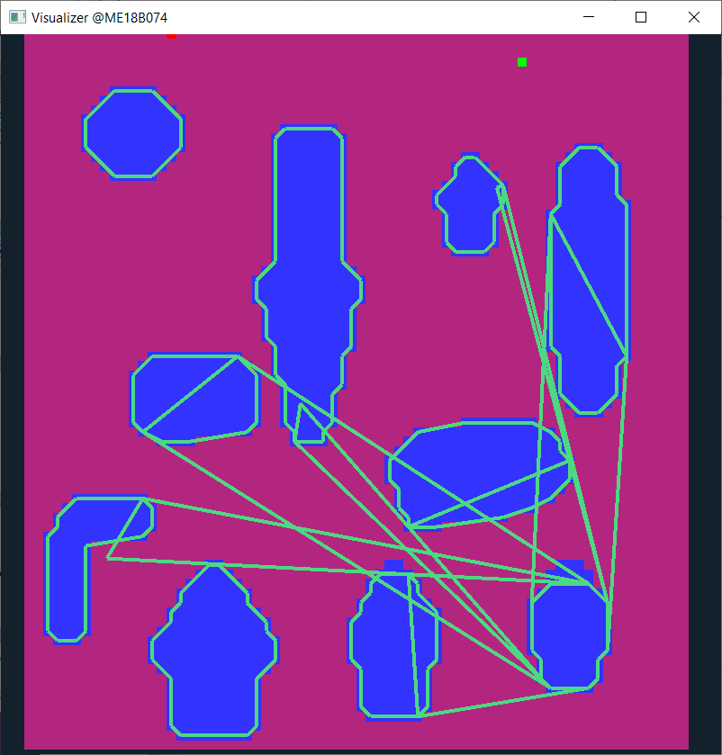
My _ Algo Shortcomings
Tangent method is failing here. Too much convex shape

Slide 19
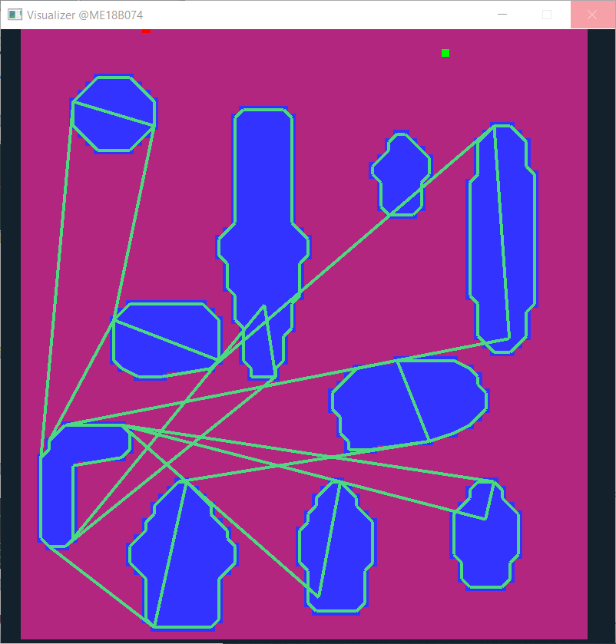
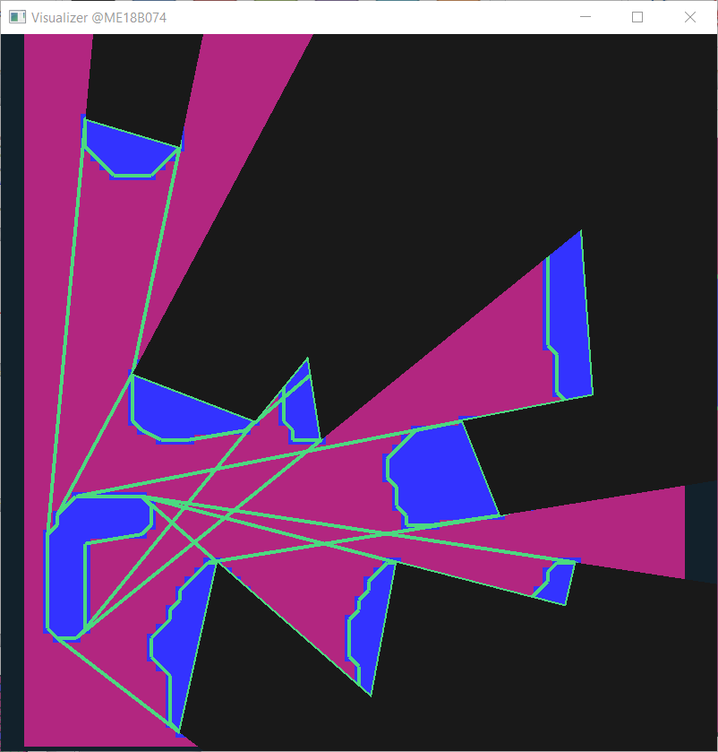

Slide 20
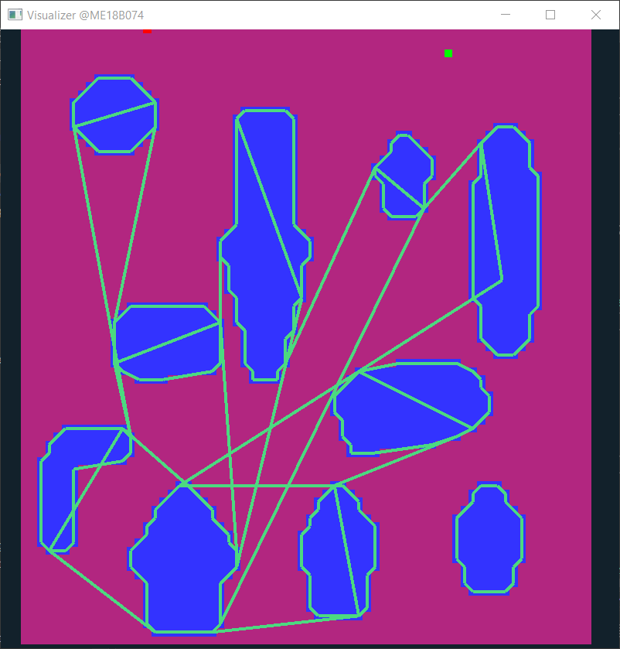
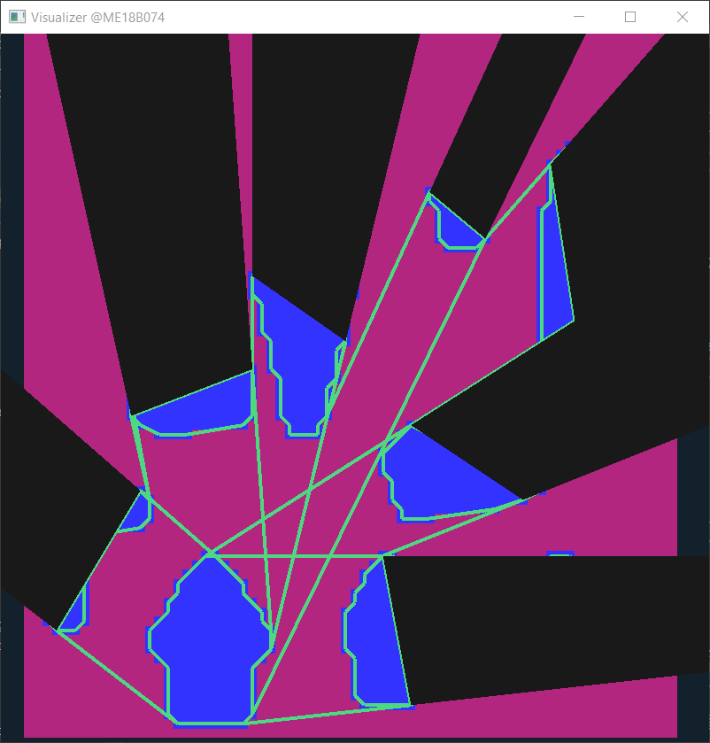

Slide 21
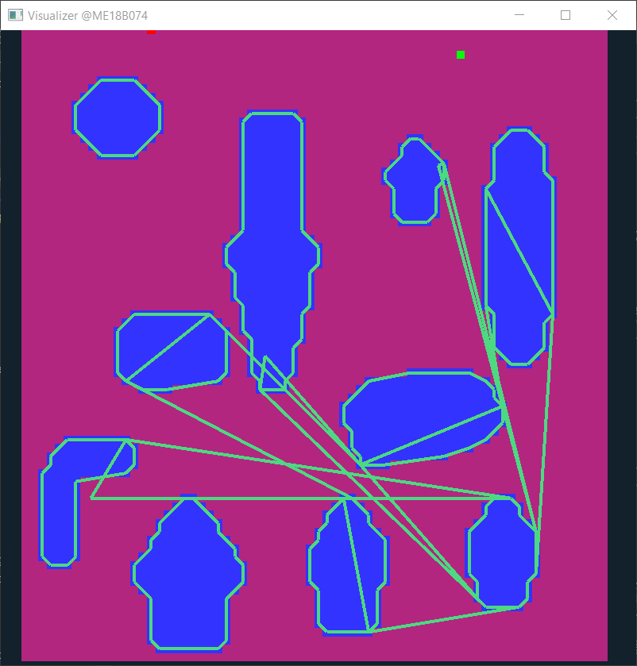
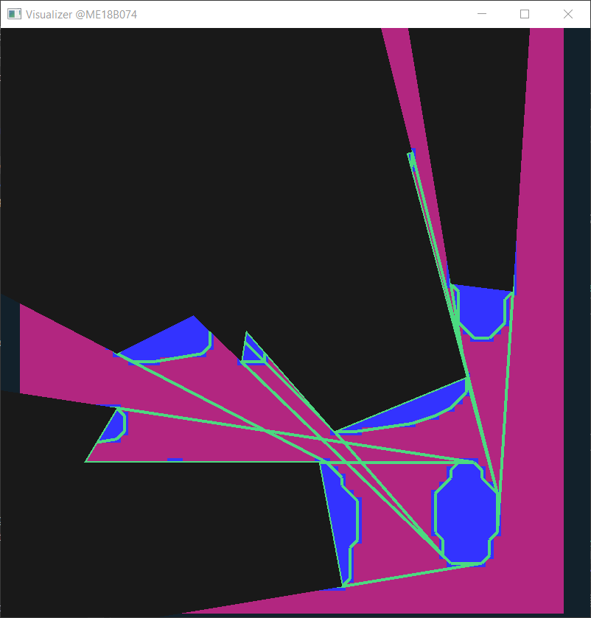

Slide 22
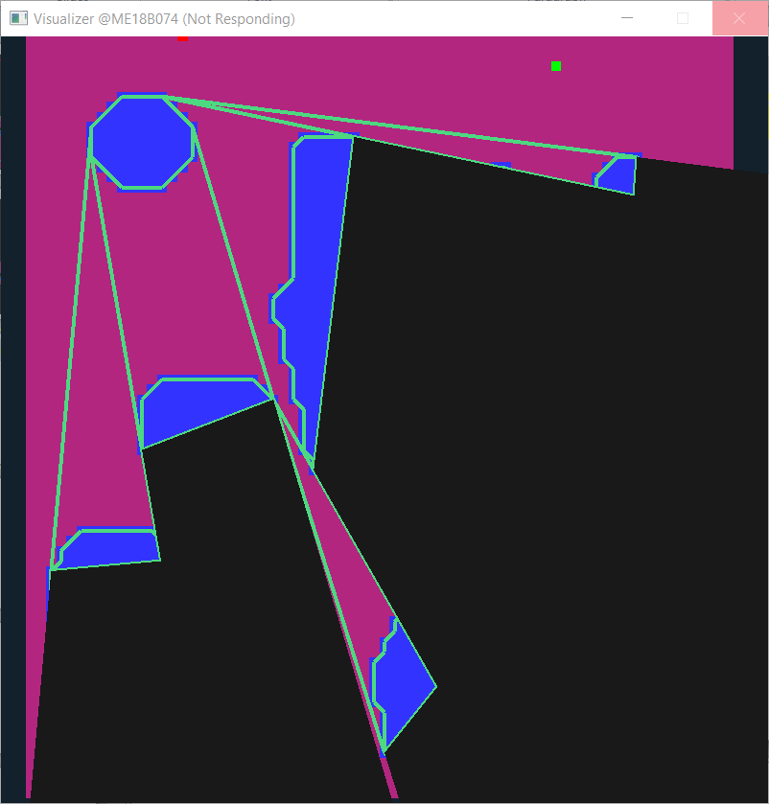
Archives – Visibility Graphs

Slide 23
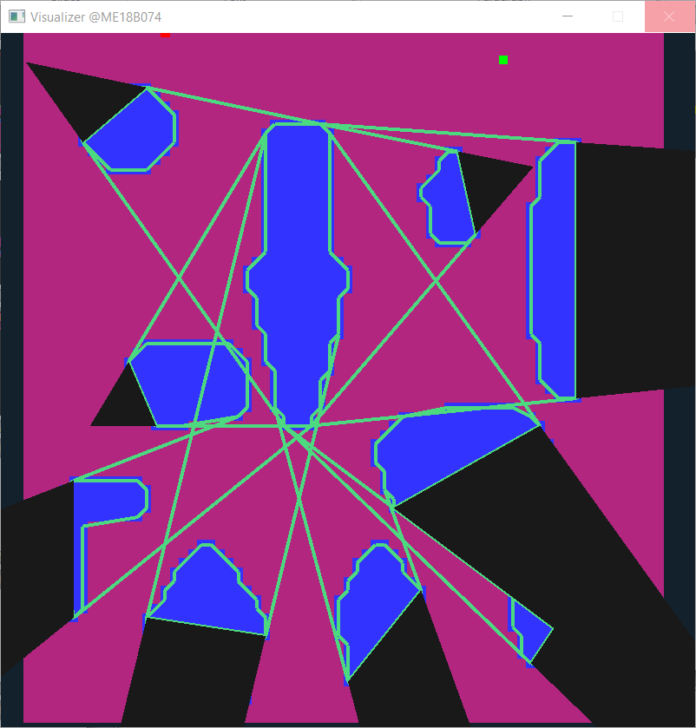
Archives – Visibility Graphs

Slide 24
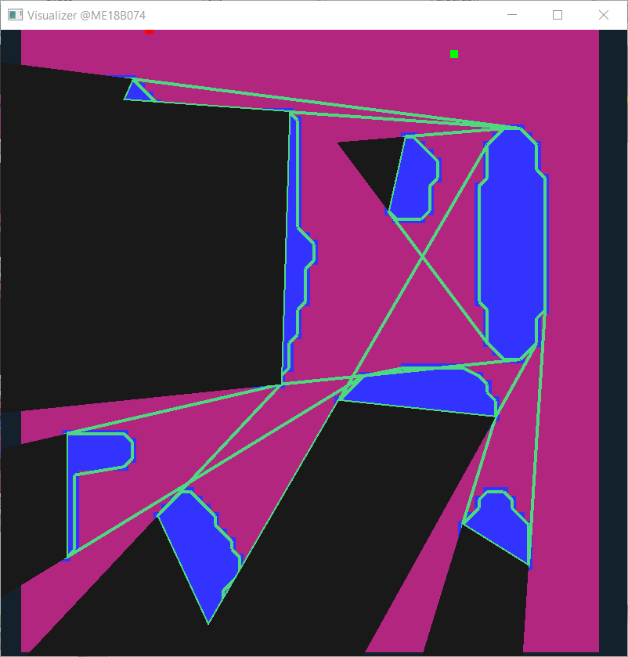
Archives – Visibility Graphs

Slide 25
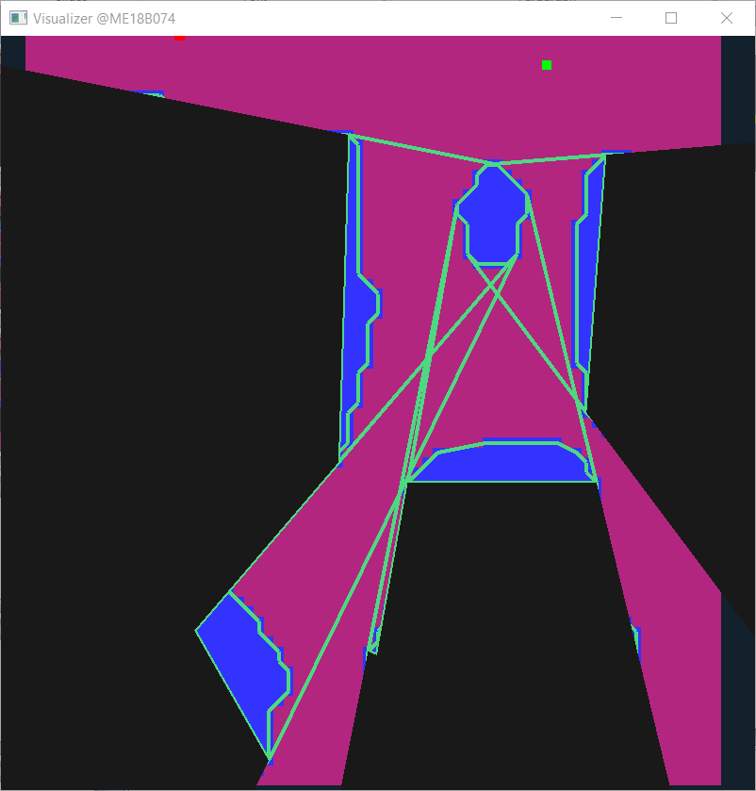
Archives – Visibility Graphs

Slide 26
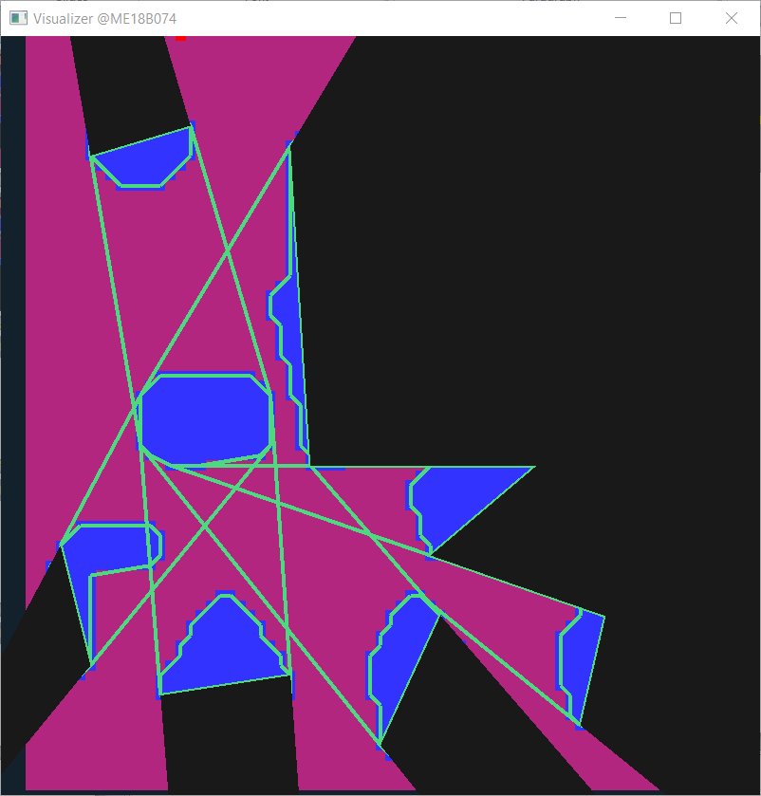
Archives – Visibility Graphs

Slide 27
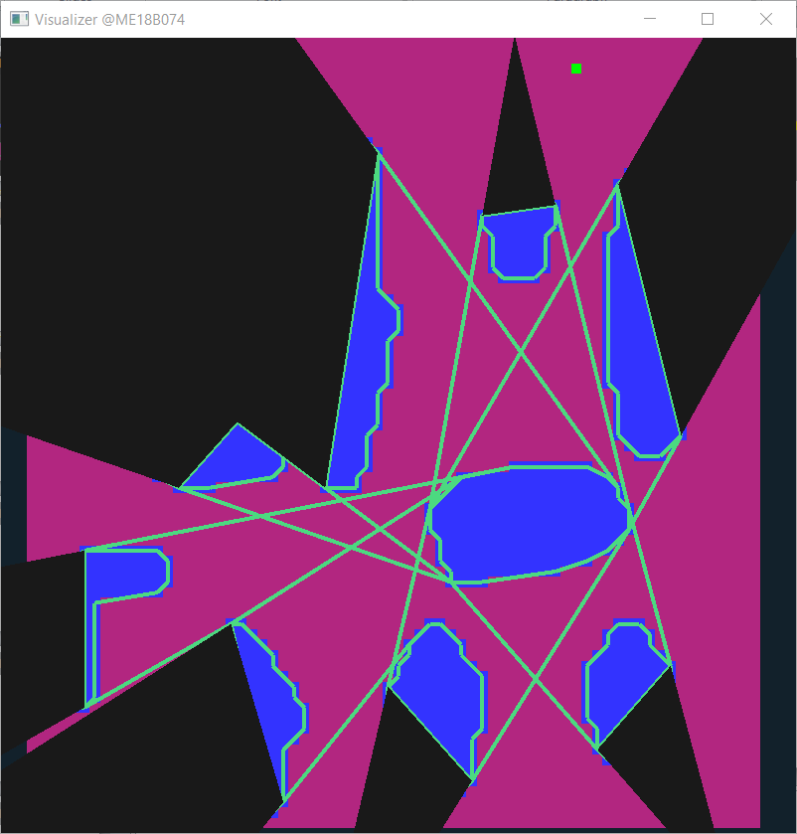
Archives – Visibility Graphs

Slide 28

Archives – Visibility Graphs

Slide 29

Archives – Visibility Graphs

Slide 30
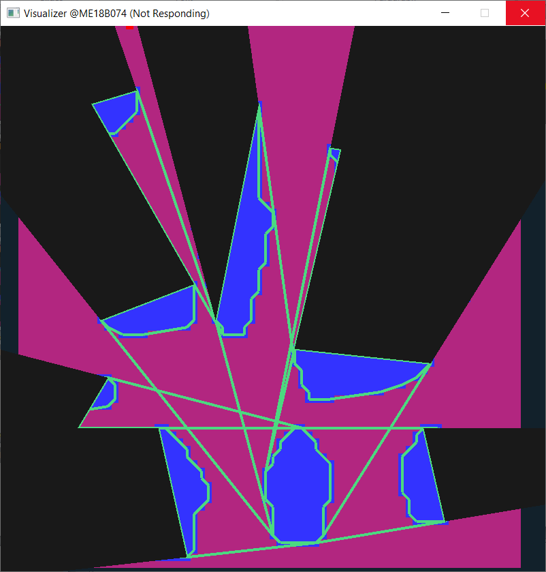
Archives – Visibility Graphs

Slide 31

Archives – Visibility Graphs

Slide 32
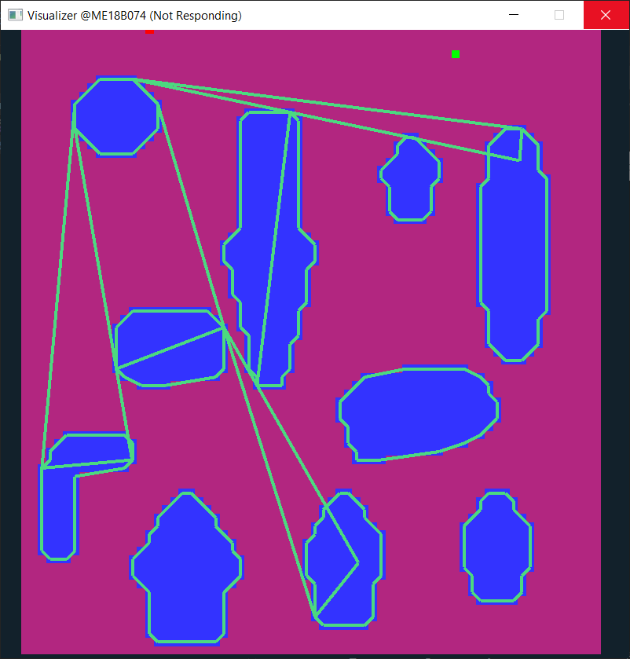
Experiments

Slide 33
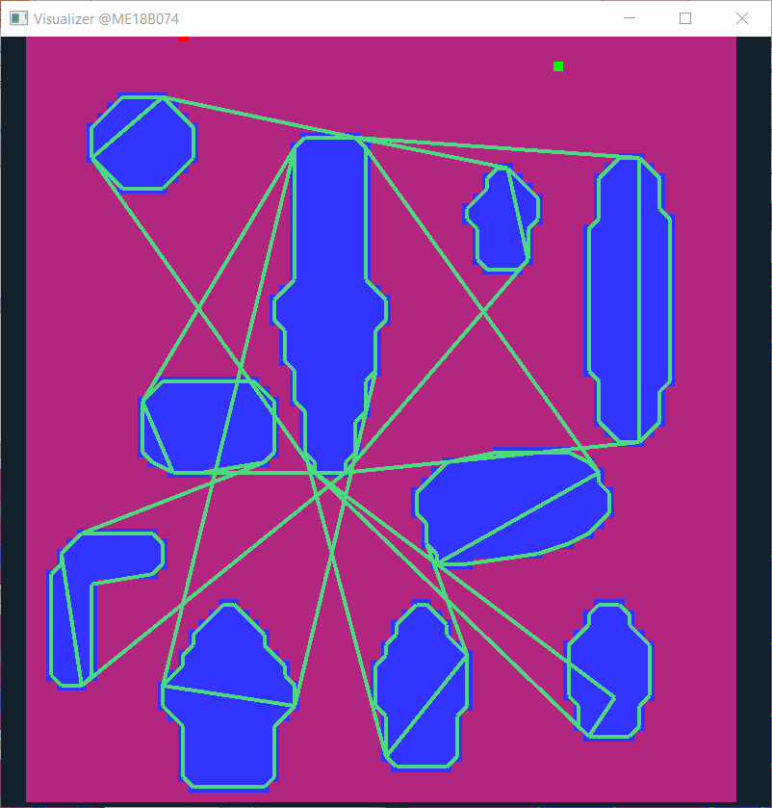
Experiments

Slide 34
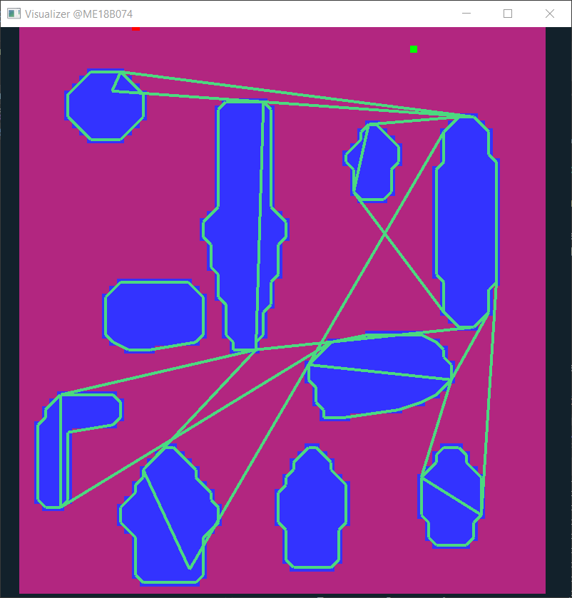
Experiments

Slide 35
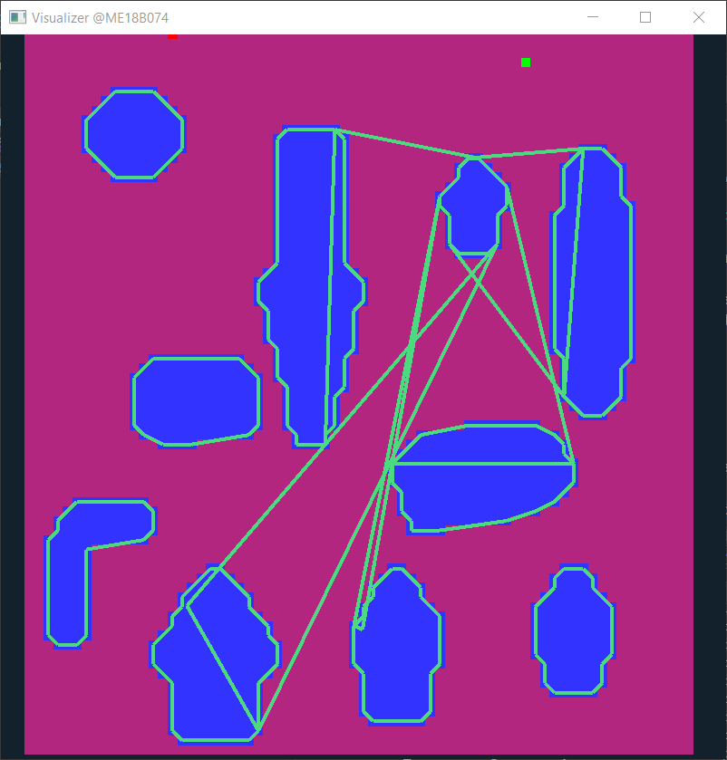
Experiments

Slide 36
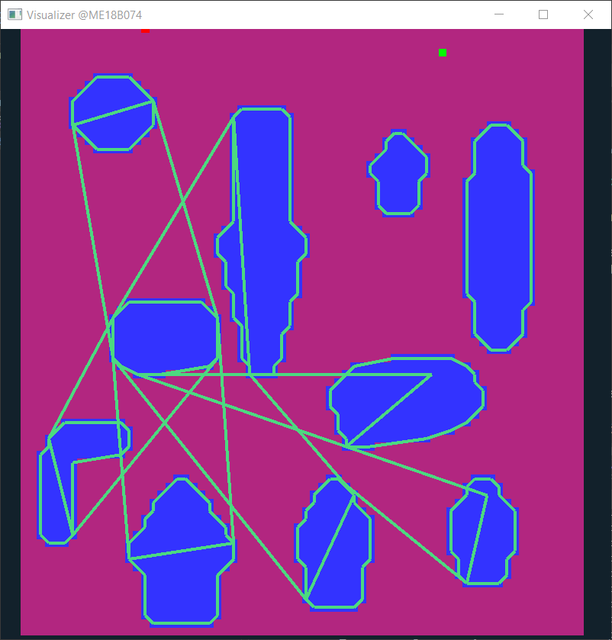
Experiments

Slide 37
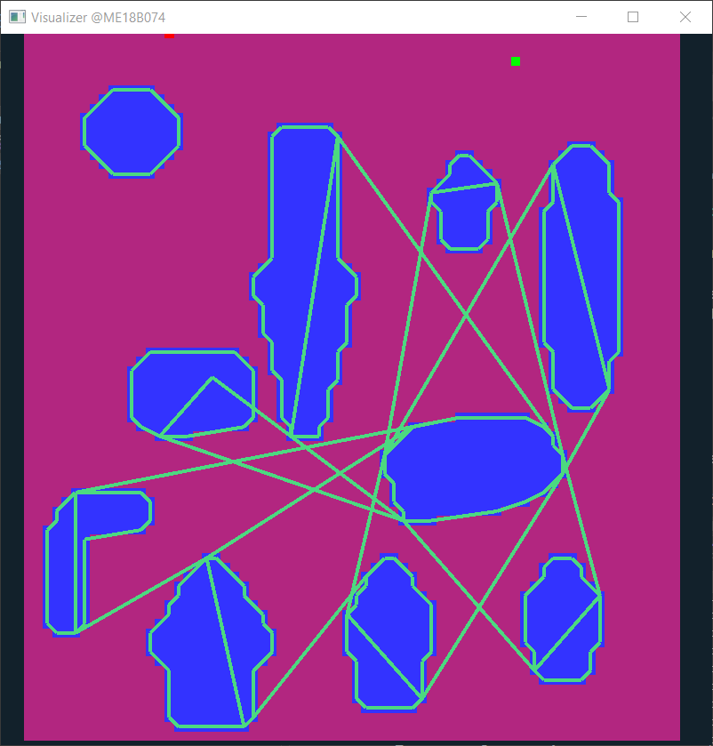
Experiments

Slide 38
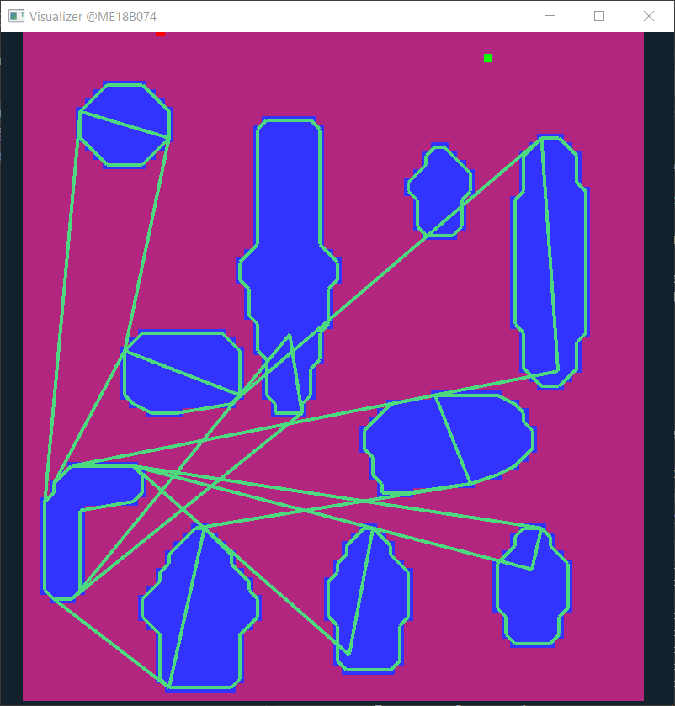
Experiments

Slide 39

Experiments

Slide 40
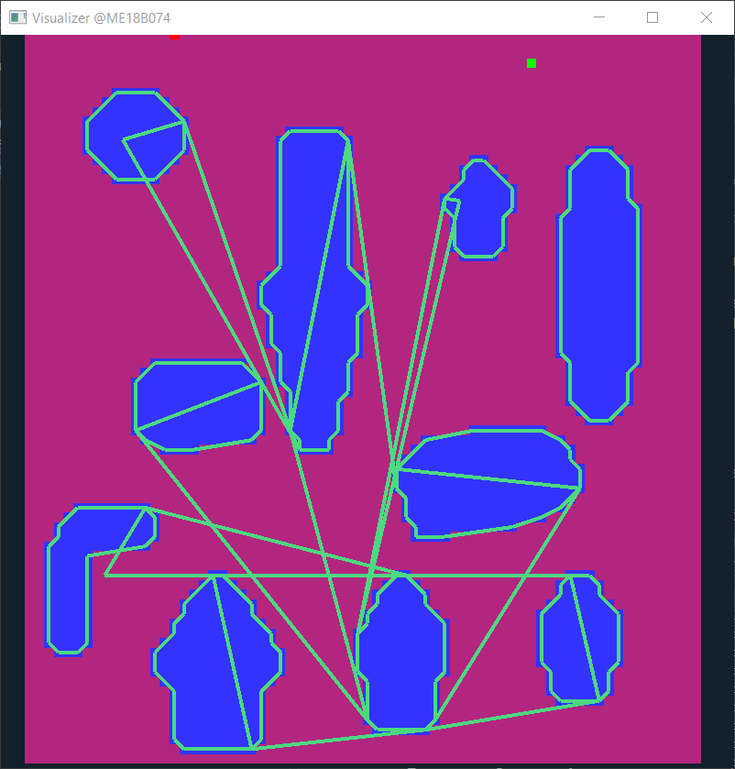
Experiments

Slide 41

Experiments

Slide 42
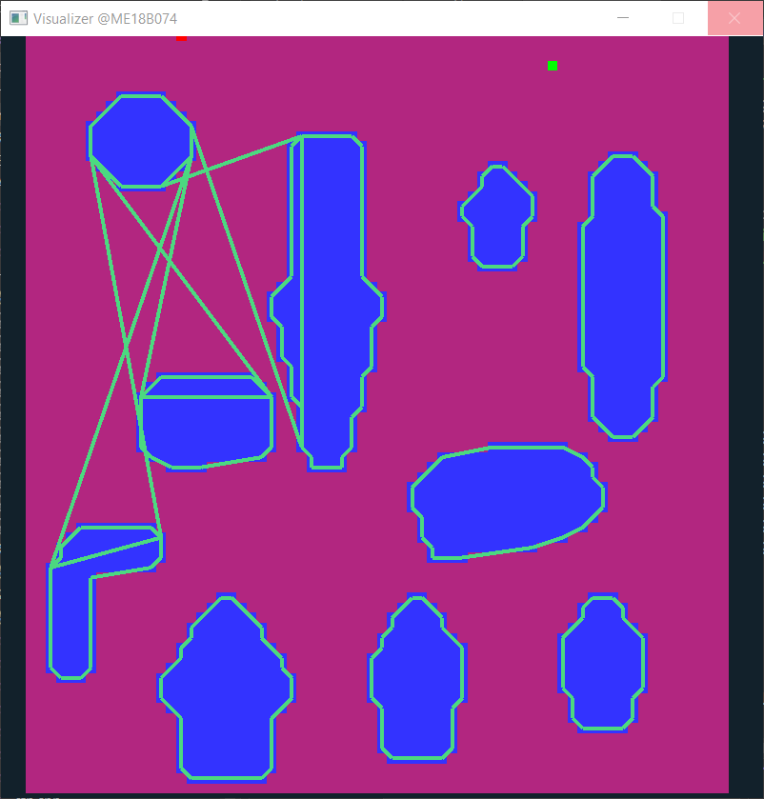
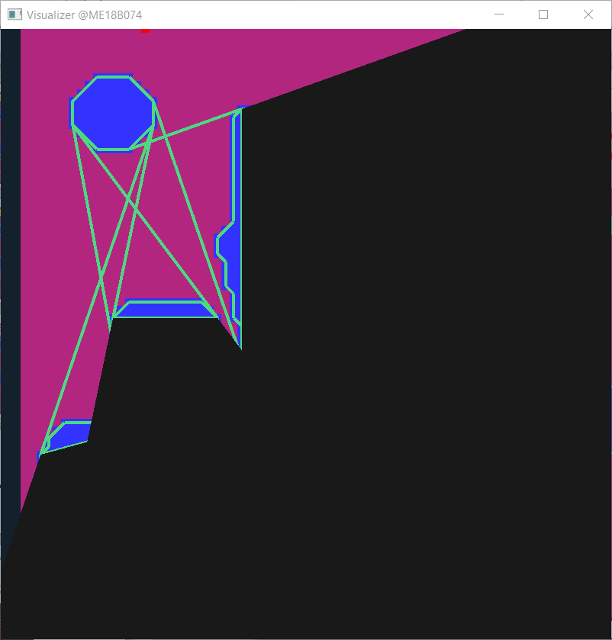
Experiment Set II

Slide 43
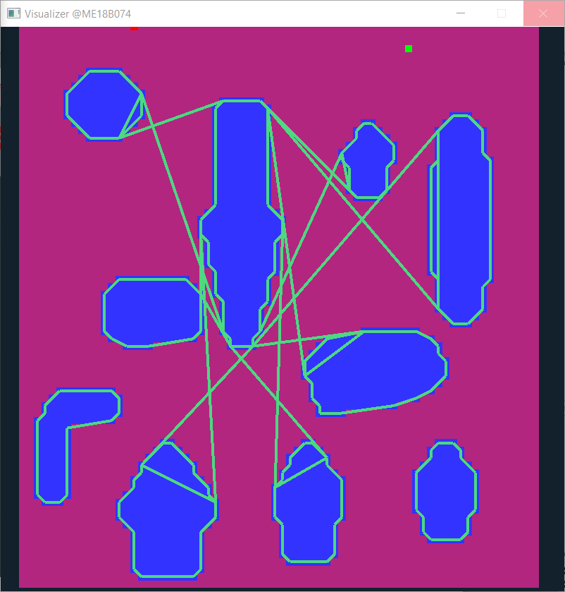
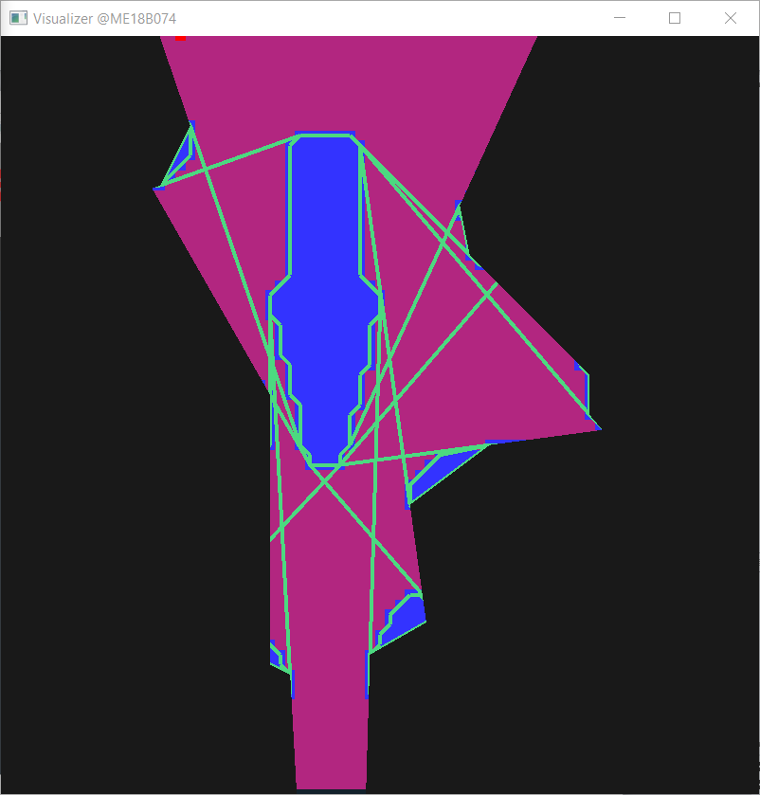
Experiment Set II

Slide 44
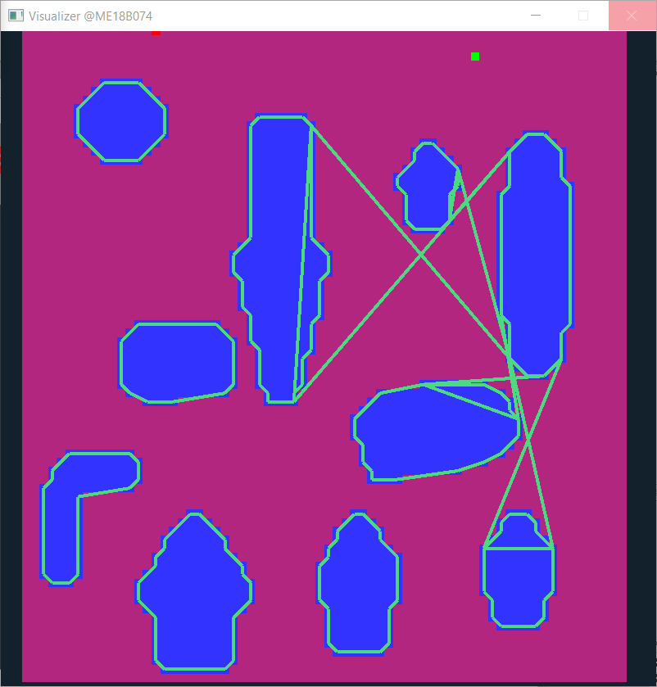
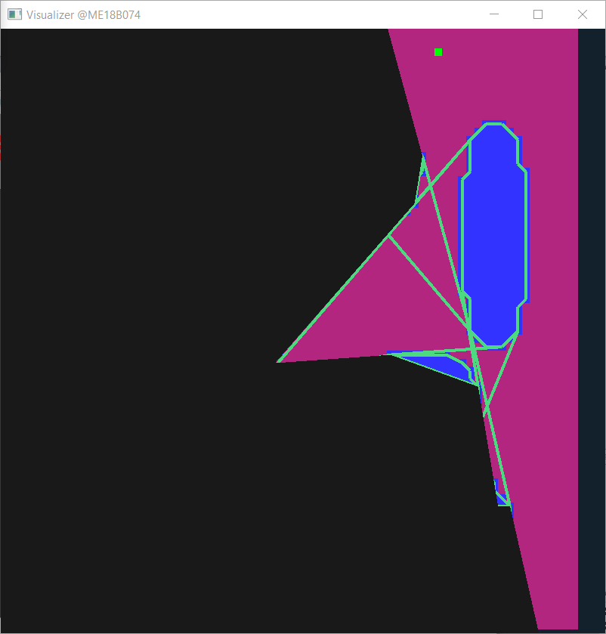
Experiment Set II

Slide 45
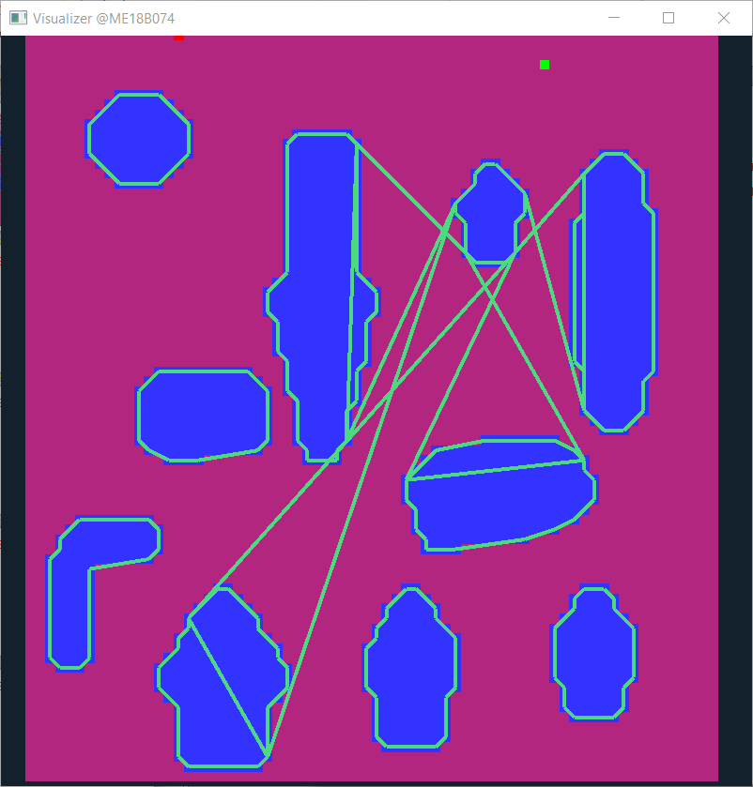
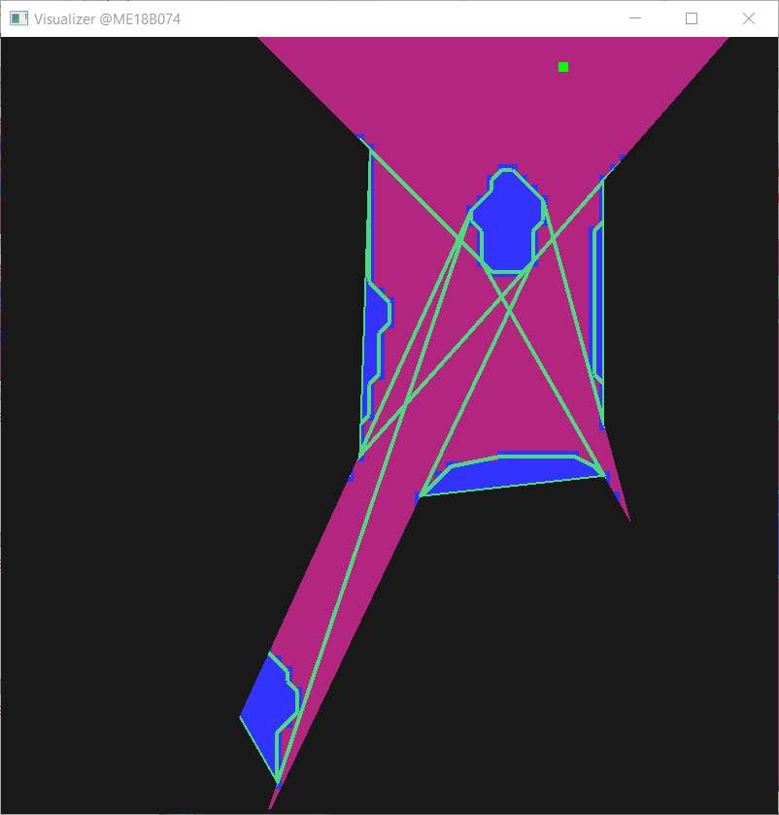
Experiment Set II

Slide 46
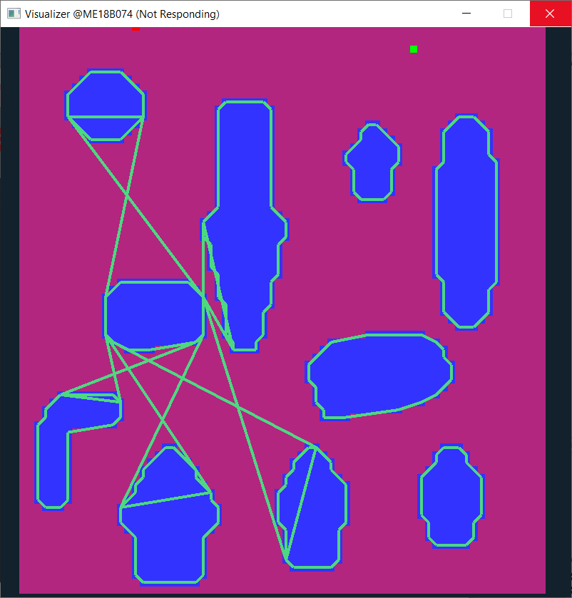
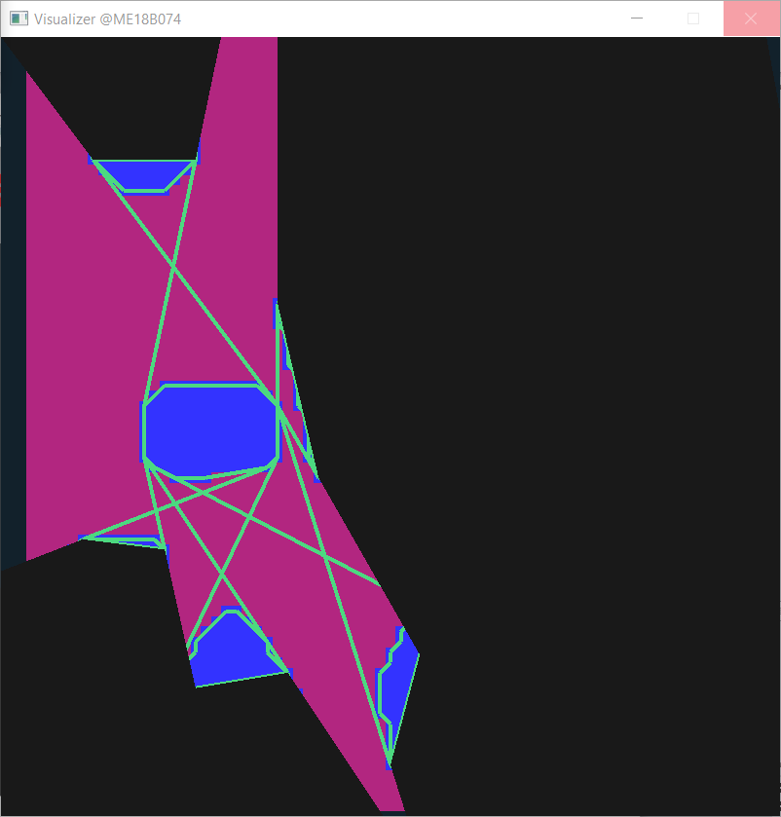
Experiment Set II

Slide 47
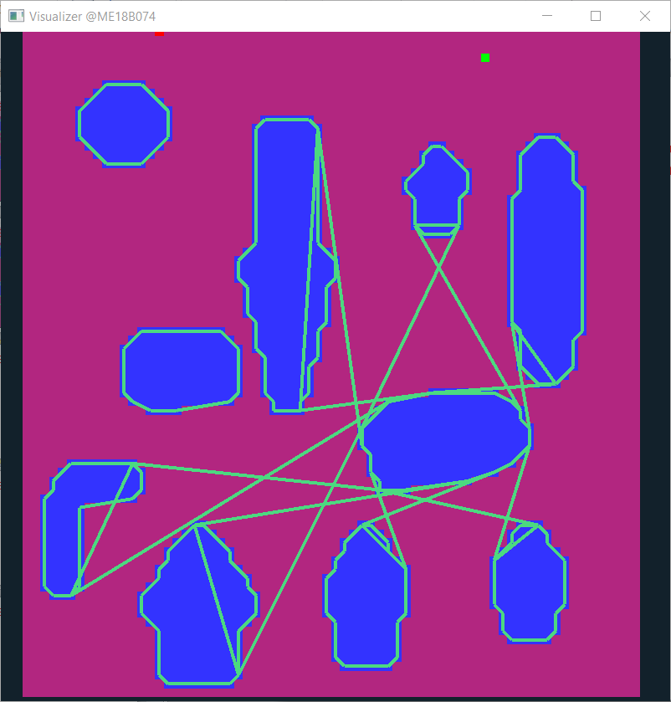
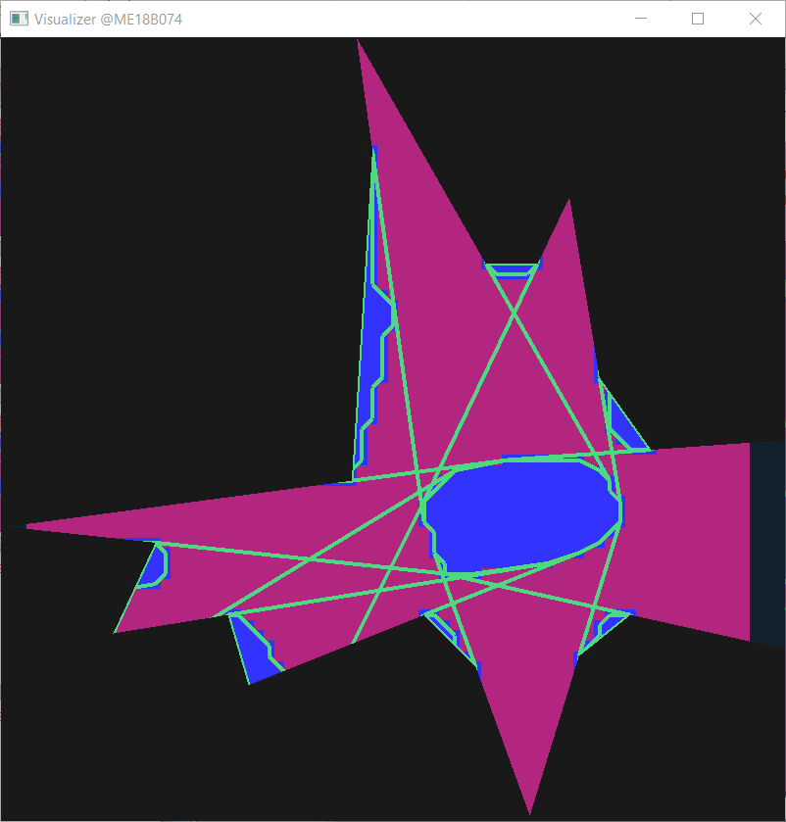
Experiment Set II

Slide 48
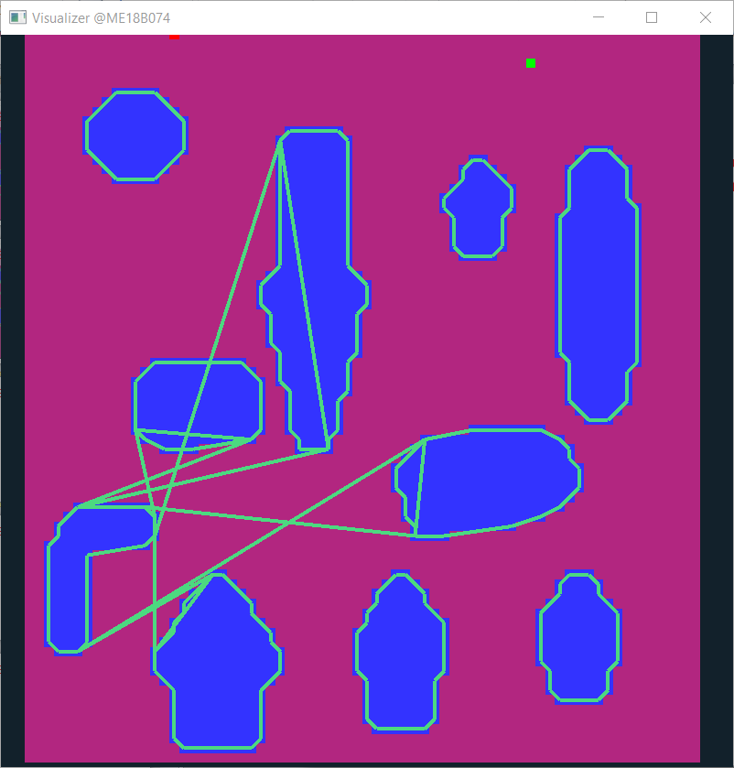
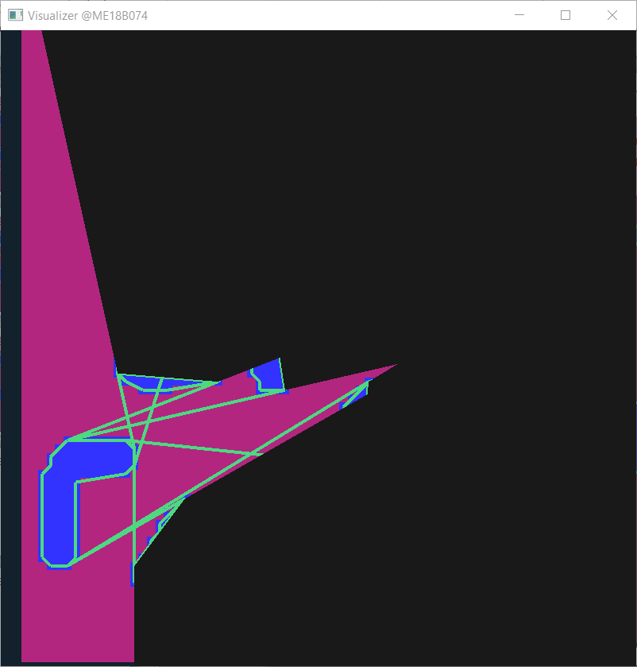
Experiment Set II

Slide 49
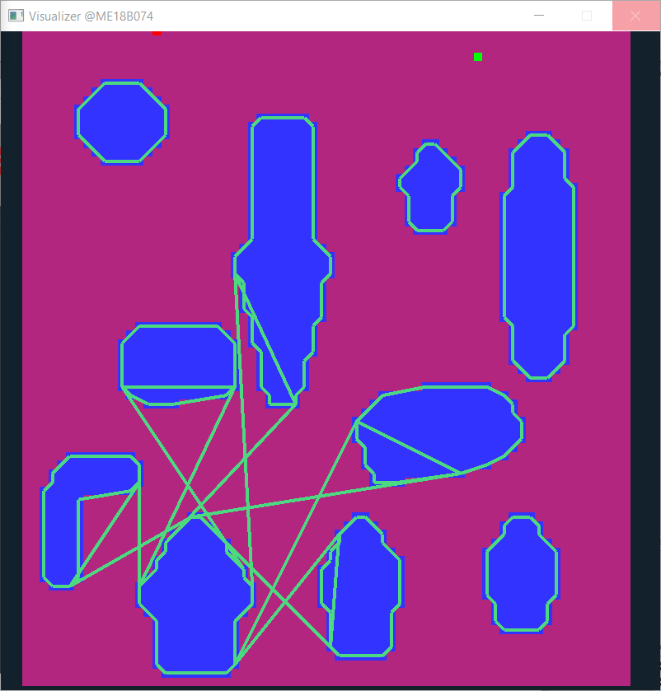
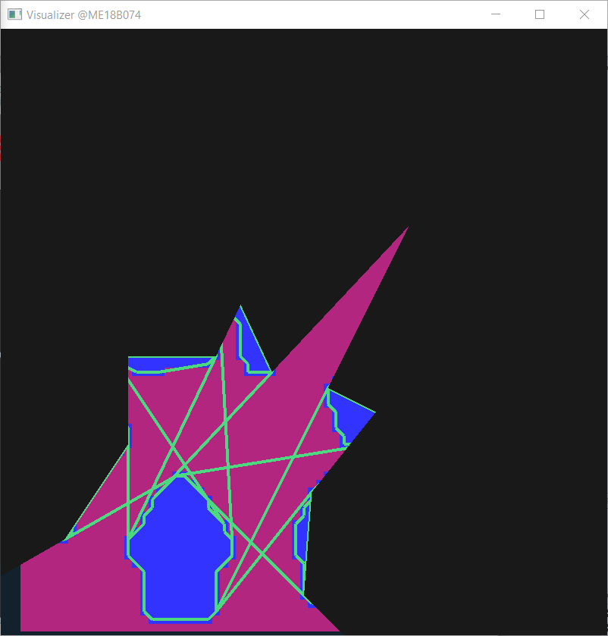
Experiment Set II

Slide 50
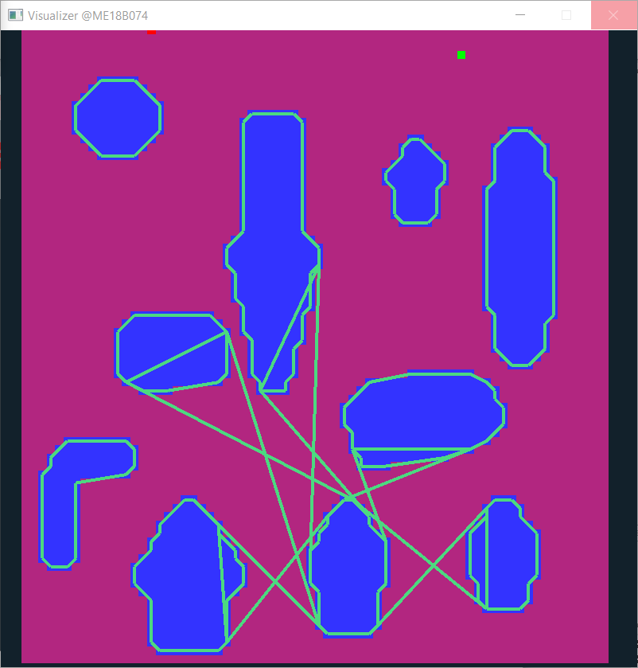
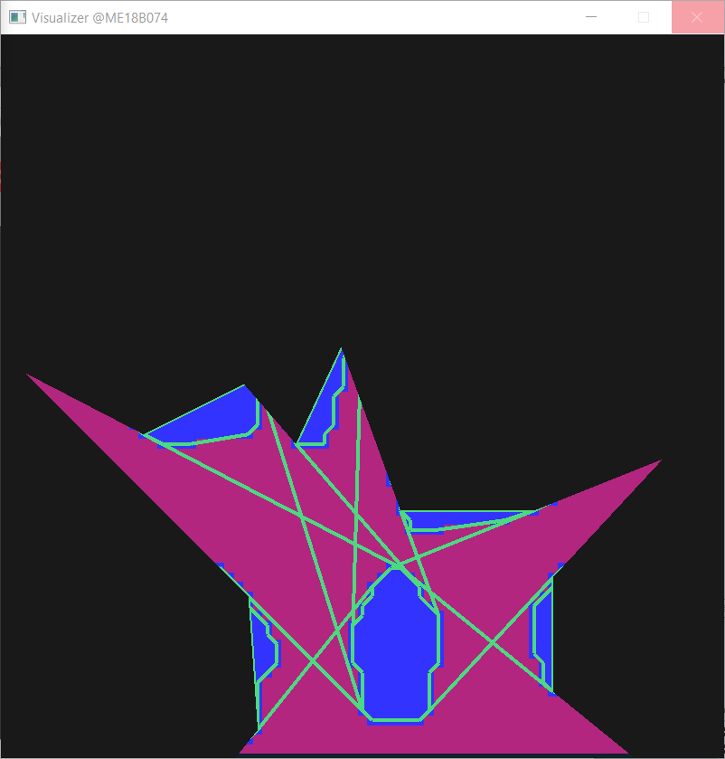
Experiment Set II

Slide 51
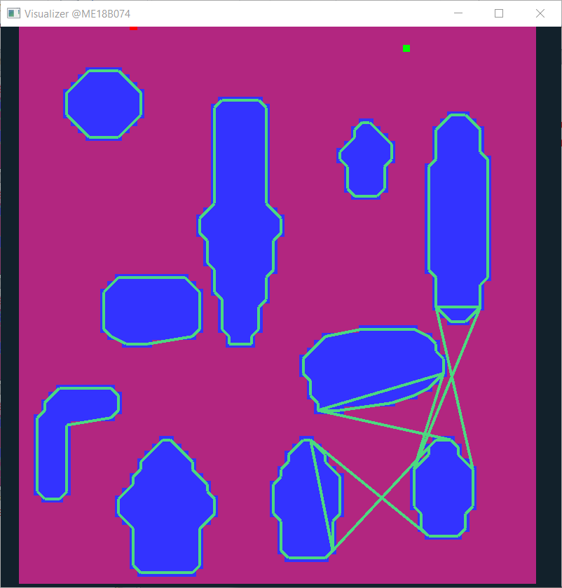
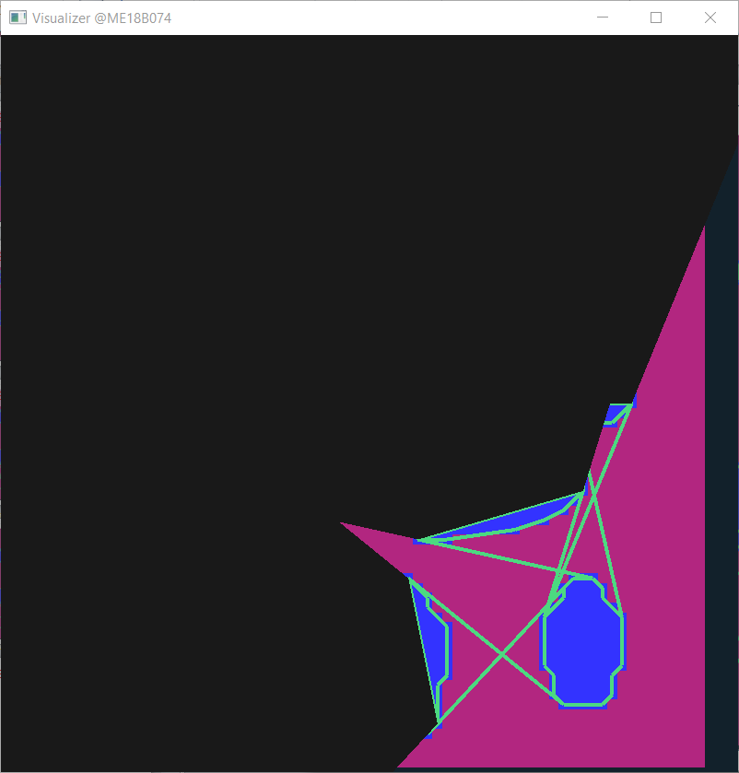
Experiment Set II

Slide 52
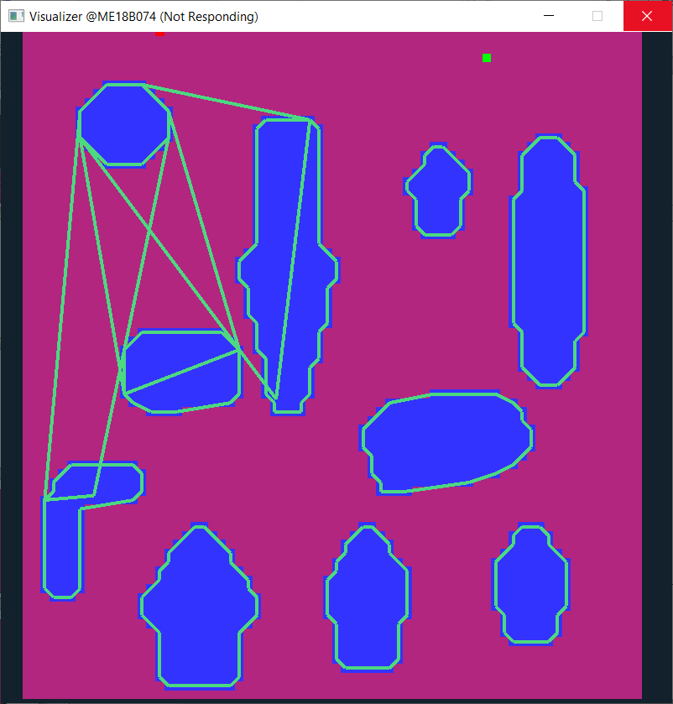
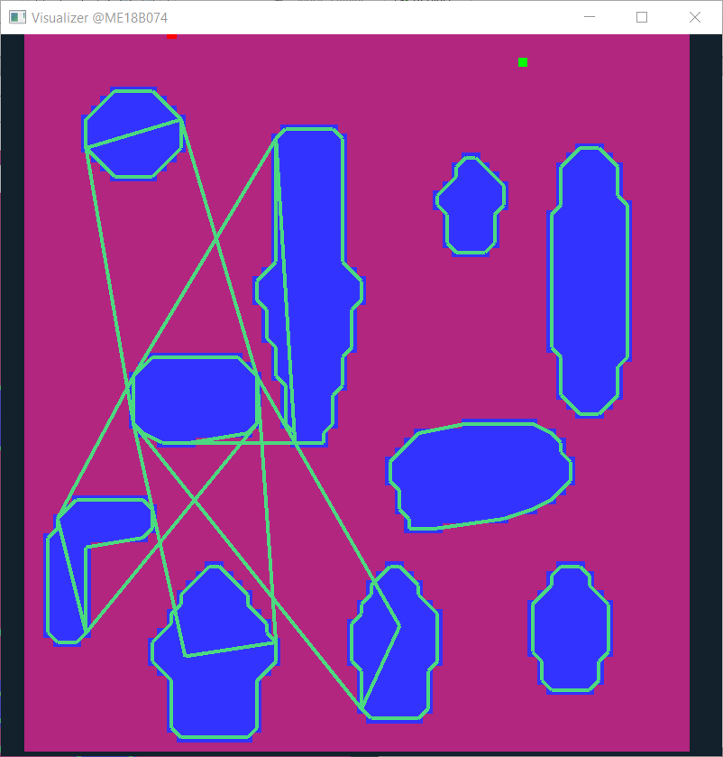
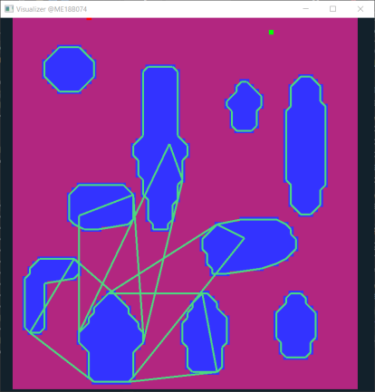
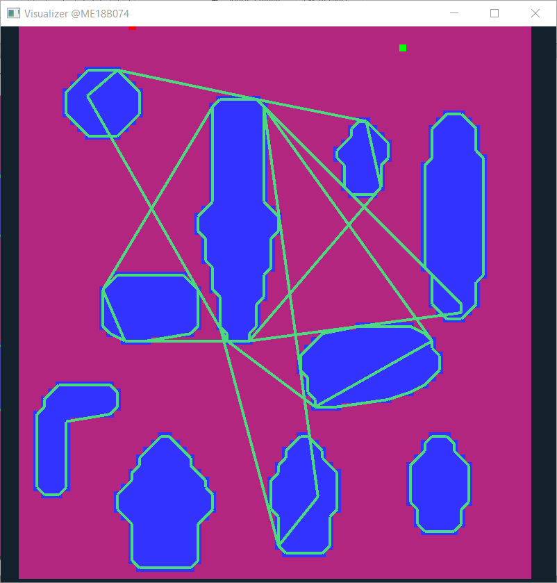
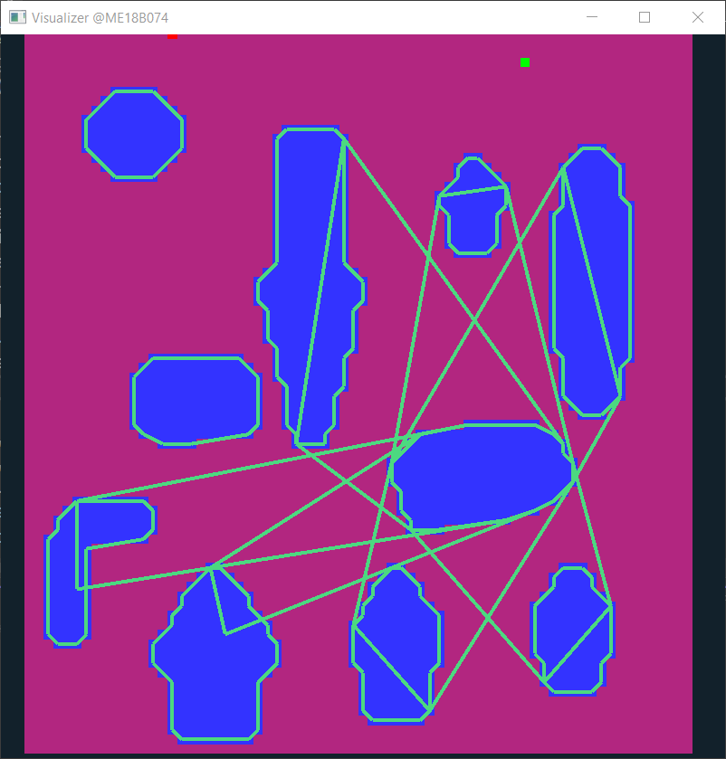





Slide 53
Current Algorithm

Slide 54

Nearest Neighbour Algo
1
4
2
3
5
6
7
9
10
8

Slide 55
Nearest Neighbour Algo
1
4
2
3
5
6
7
9
10
8

Slide 56

Nearest Neighbour Algo
1
4
2
3
5
6
7
9
10
8

Slide 57
Nearest Neighbour Algo
1
4
2
3
5
6
7
9
10
8

Slide 58

Algo
Step 1 : converting image data into polygonal data
Read image row by row

Slide 59

Algo
Step 1 : converting image data into polygonal data
Read image row by row
Identify the strip-obstacles in each row; store these stip data in vectors

Slide 60
Algo
Step 1 : converting image data into polygonal data
Read image row by row
Identify the strip-obstacles in each row; store these strip data in vectors
Traverse through these vectors top down; and keep merging the strips

Slide 61

Algo
Step 2 : Create voronoi like graph for these 2D polygons
Iterate through each polygon to create its neighbour map
For each fixed polygon; iterate through other polygons based on shortest distance from fixed polygon
if the polygon is completely shielded by existing neighbours; jump to next.
If a part of polygon is exposed. Calculate its tangents. And add it to neighbours list.
This graph generation is one time computation

Slide 62
Algo
Step 3 : Use this near voronoi graph to compute best possible path (in real time)
And done!

Slide 63
Why and How ellipses kicks in.. In this Algo
Some crucial steps in this algorithm are:
Tangent Computation:
For polygonal object; this computation is of the order O(m*n)
For ellipses that will become constant time operation
For computing path width: optimal path calculation:
With ellipse representation; path width between neighbour ellipses can be estimated in constant time.
Elliptical Estimation:
- We are going with an approach where no. of ellipses can be varied to estimate a polygon. So this step can itself reduce the computation, when quick estimates are required.

Slide 64
Going 3D…
Represent obstacles with Ellipsoids instead of ellipse
Transform the trapezoidal unit idea to conical frustum idea in 3D.
And done!

Slide 65

Shortcoming

Slide 66

Graph Building
 | 1 | 2 | 3 | 4 | 5 | 6 | 7 | 8 | 9 | 10
1
2
3
4
5
6
7
8
9
10
1
4
2
3
5
6
7
8
9
10

Slide 67
Graph Building
1 | 2 | 5 | 7
2 | 1 | 3 | 4 | 5 | 6 | 9
3 | 4 | 6 | 10
4 | 2 | 3 | 6 | 8
5 | 1 | 2 | 7 | 8 | 9
6 | 2 | 3 | 4 | 7 | 8 | 9 | 10
7 | 2 | 5 | 8
8 | 2 | 5 | 6 | 7 | 9
9 | 2 | 5 | 6 | 8 | 10
10 | 3 | 6 | 9
1
4
2
3
5
6
7
8
9
10

Slide 68
How to go?
Set unique identifier for each of the quads
Set priority value for each quad
Iterate through the “polygon-dual”(s) on polygon- graph
And build quads graph:
-- While iterating for each quad; check if a quad intersects existing quad in the graph
-- If yes : add this quad pointer to graph
For path planning; find a path in terms of quads
Convert it to path in terms of grid cell using local A-star

Slide 69


Slide 70

Partial Success

Slide 71



Slide 72
Observations

Slide 73


Simple Graph Search Algo
For each cell; first check if path exists with left; then check right, top, bottom subsequently
Too much inefficient; but atleast ensures finding a path if exists

Slide 74



A* based on forward heuristics only
A kernel type cost function can be introduced to further shorten the path found.
Kind of “flood-fill” + A*

Slide 75


A* based on forward heuristics only
A small change
Rather than stopping algorithm; when goal is hit for the first time.
It is allowed to continue till all the open branches reach their end goal.
Path with least cost is taken as best path
New Objective:
Find the best path in the first hit
Before change
After change

Slide 76


Slide 77
Important steps/ considerations in path planning
Representation of environment as graph; combining maximum information in a node object-class in minimum space
Graph creation step: linking empty/obstructed neighbours together to form graph.
Method of exploring graph?
Going start to end OR end to start
Breadth-wise exploration or Depth-wise exploration
Killing algorithm on first hitting goal point or continue till each node has been explored
Extracting Path : backtracing pointers from goal to start (after algo solver step)

Slide 78
A_star : More heavy memory wise; stack overflow for 600*600 map
Genetic : guarantees a path if exist (atleast in infinite iterations) but doesn’t guarantee optimal path; stack overflow for 600*600 map

